Slide 1

Watering Dashboard Project
Students’ names:
Elad Hayek – 211873542
Shirin Fakiri – 208154815
Daniel Gunko – 340969674
Gleb Tyutrin – 324726306
Moderators' names: Eliel Yeshayahu, Netanel Zohar

Slide 2
Table of Contents
Goal
3
Requirements from Specification
26
01
06
Existing Technologies & Market Solutions
4
Unexpected Problems
27
02
07
Main Processes
5-7
Coping & Solving
28
03
08
Main Modules
8-15
Conclusions for Further Development
29
04
09
Main Products
16-25
05

Slide 3
Goal
Creating a WEB-based system that provides an efficient solution for managing and monitoring watering zones and plants. The system helps teams maintain up-to-date area boundaries, plant status, watering details, photos, permissions, and activity history.
Area Boundaries
Plant Status
Watering Details
Photos
Permissions
Activity History

Slide 4
Existing Technologies and Market Solutions
International Solutions
Netafim Digital Farming – smart irrigation monitoring and control for agricultural sites.
HydroPoint WeatherTRAK – weather-based irrigation management for landscapes and municipalities.
ThingsBoard Smart Farming – IoT dashboard for sensors, telemetry, and field monitoring.
Open-source GIS / Leaflet – web mapping technology for drawing areas and viewing field assets.
Israeli Solutions:
Netafim – Israeli drip-irrigation and precision agriculture technology.
SupPlant – Israeli sensor-based irrigation recommendations for crops and orchards.
CropX – Israeli soil intelligence platform for irrigation and agronomic decisions.

Slide 5
Main Processes
Task Management
System users register, log in, and manage watering areas directly from the interactive map.
Users can define new areas as rectangles or polygons, add plants inside those areas, and upload reference photos.
Task Execution
When adding or editing plants, the system checks that the plant location is inside a valid area.
Data is validated before saving, including coordinates, watering frequency, volume, and plant status.
Each database action triggers an audit entry that records who made the change.
Mission Completion
After creation or update, the dashboard refreshes the map and database data.
The audit log keeps all create, update, delete, and login actions visible through the activity pages.

Slide 6
Main Processes
1. User Process
Users register with a verified 9-digit ID and log in securely.
The system validates credentials, stores the user session, and logs important activity.
Role-based access controls determine what the user can view or edit.
2. Area Management Process
Users draw watering areas on the map using rectangle or polygon boundaries.
The system stores boundary coordinates and prevents invalid updates.
Area managers can assign users to areas with read, update, or area-manager permissions.
3. Plant Management Process
Plants are placed inside defined areas using map coordinates or image coordinates.
The system validates the plant position and stores watering frequency, volume, health status, and notes.
Users can edit or delete plants when they have the correct permission.

Slide 7
Main Processes
4. Photo Management Process
Areas support photo uploads for image-based workspaces and field documentation.
Files are stored under the local uploads directory and linked to the area record.
Image dimensions are saved so plant coordinates can be checked inside the uploaded image.
5. Audit & Notification Process
Every significant system event is recorded in the audit_log table.
The activity and notification pages display these records with user, action, entity, and time details.
This gives administrators and area managers clear operational visibility.

Slide 8
Main Modules
The system is built using a client-server architecture based on the MVC pattern.
The frontend (View) is developed with React and Leaflet, providing an interactive map-based interface for managing watering areas and plants.
The backend (Controller + Model) is developed with Node.js and Express and communicates with a MySQL database.
Each user action triggers a full cycle:
The frontend sends an HTTP request to the backend.
The router directs it to the correct route file.
The controller validates input and permissions.
The model/database layer reads or writes MySQL records.
The audit module records the action.
The backend returns a structured JSON response to the frontend.

Slide 9
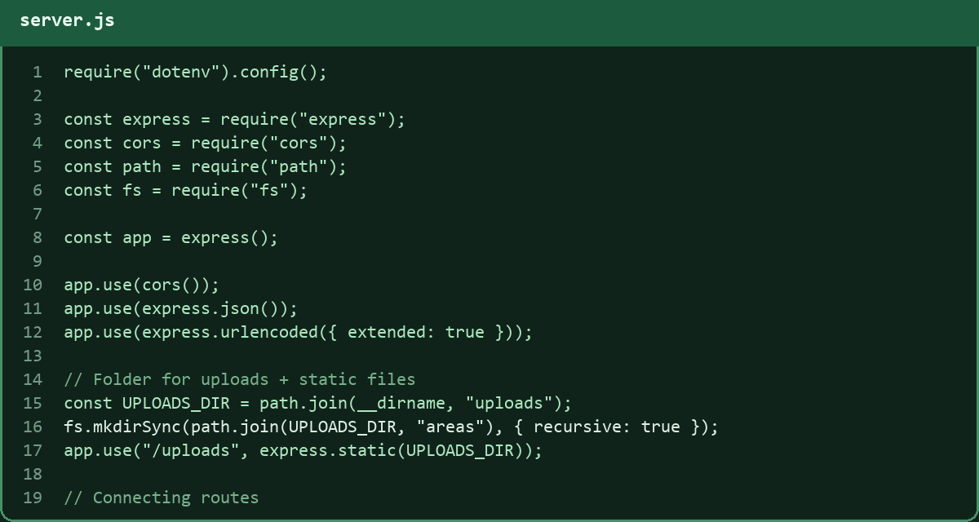
Main modules – Starting the server
1
Load environment variables and configuration.
2
Initialize the HTTP server using Node.js and Express.
3
Enable CORS, JSON parsing, form parsing, and uploads.
4
Connect all route modules: areas, plants, users, and audit logs.
5
Serve uploaded files from the local uploads directory.
6
Start listening for client requests through REST APIs.

Slide 10
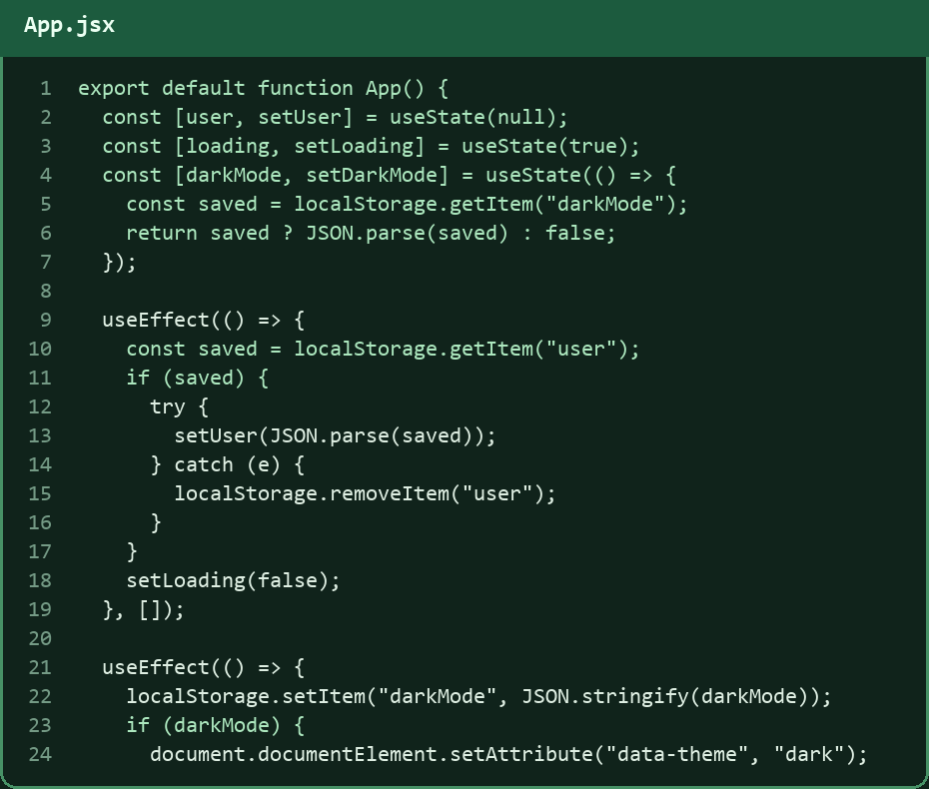
Main modules - React
Built with React for a dynamic and modular front-end.
Uses React Router for navigation between pages.
App.jsx manages the main routes and protected pages.
Stores user session and dark-mode preference in localStorage.
Uses hooks such as useState and useEffect for app logic.
Communicates with the Node.js server through REST API calls.

Slide 11
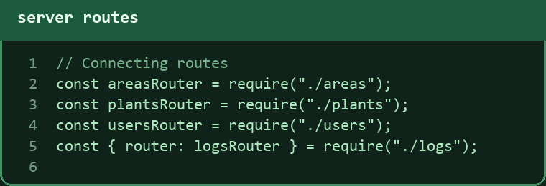
Main Modules – Routes
The server uses separate route files for plants, areas, users, and audit logs.
Each router handles its own API endpoints and client requests.
Routes connect the frontend actions to validation, permission checks, database queries, and audit logging.

Slide 12
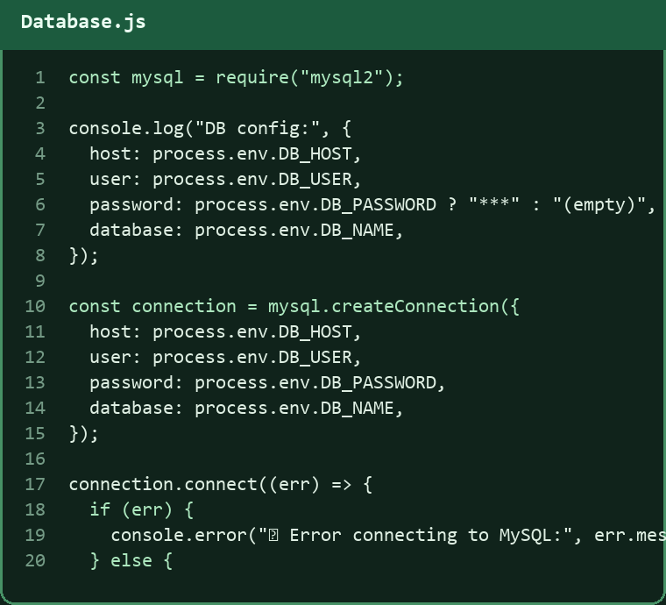
Main Modules – DB
A dedicated module (Database.js) handles the connection to the MySQL database.
Loads database configuration from environment variables.
Creates a connection using the mysql2 library.
Checks and logs the connection status.
Exports the connection object for areas, plants, users, and logs.
Keeps database access consistent across the backend.

Slide 13
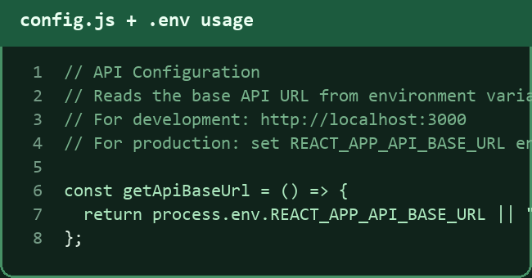
Main modules - Config
The configuration layer manages environment variables and client/server settings.
1
The server uses dotenv for database credentials and port configuration.
2
The client uses config.js to keep API URLs centralized.
3
Upload paths are defined in the server and served through /uploads.
4
This avoids hard-coded values across components and routes.
5

Slide 14
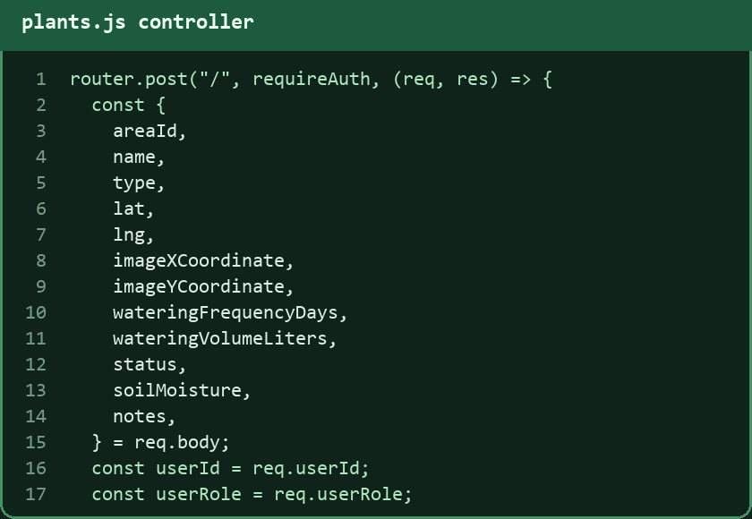
Main modules - Controllers
The controller receives HTTP requests from the frontend, checks authentication and permissions, validates the data, performs database operations, writes audit entries, and sends an appropriate JSON response back to the client.

Slide 15
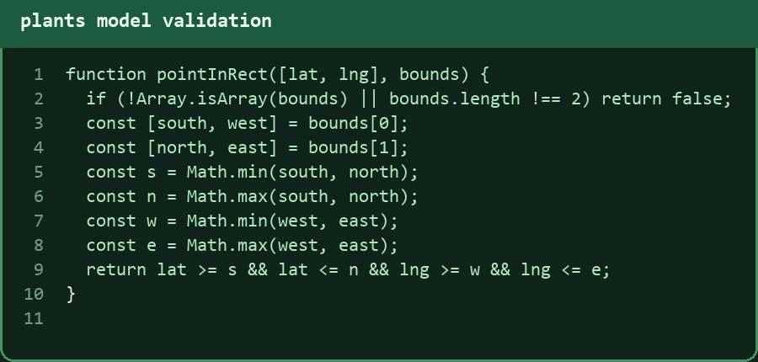
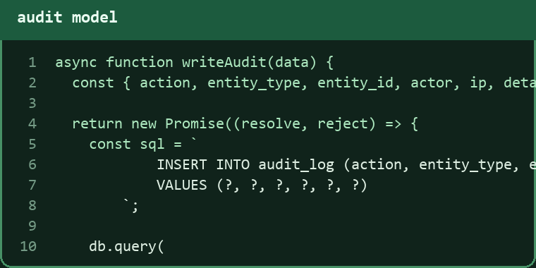
Main modules - Models
The model layer is responsible for core data operations in the system:
Communicating with the MySQL database.
Handling data validation for users, areas, and plants.
Managing relationships between users, area permissions, and plant records.
Checking map or image coordinates before saving plants.
Performing audit logging for every important create, update, delete, and login action.
Supporting the full HTTP request-response cycle.

Slide 16
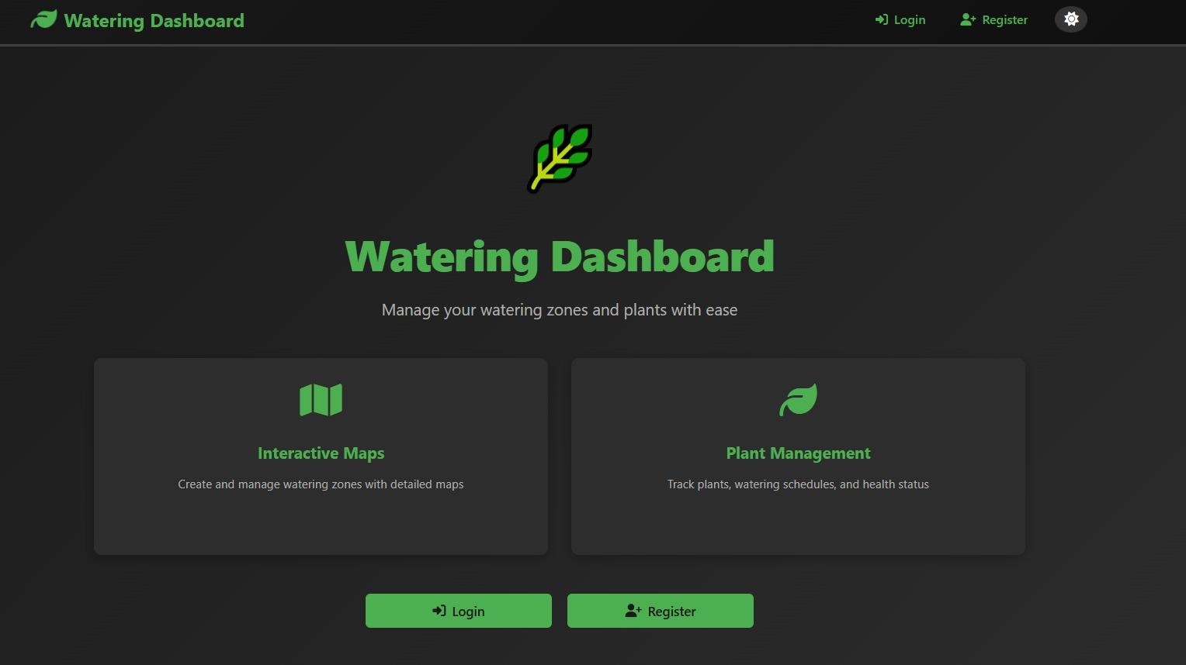
Main products: Home Page – Before Login

Slide 17
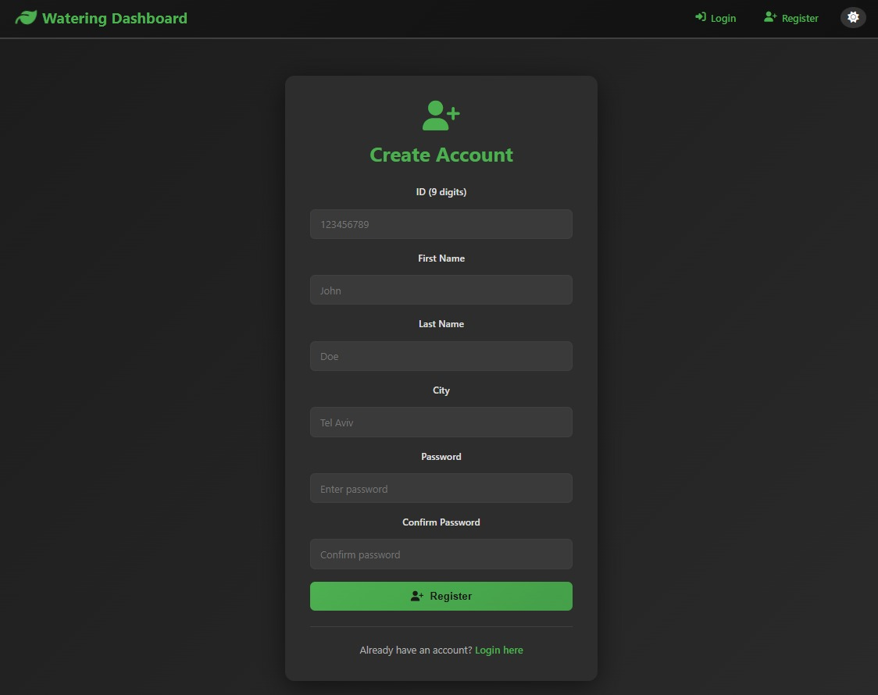
Main products: Register Page:

Slide 18
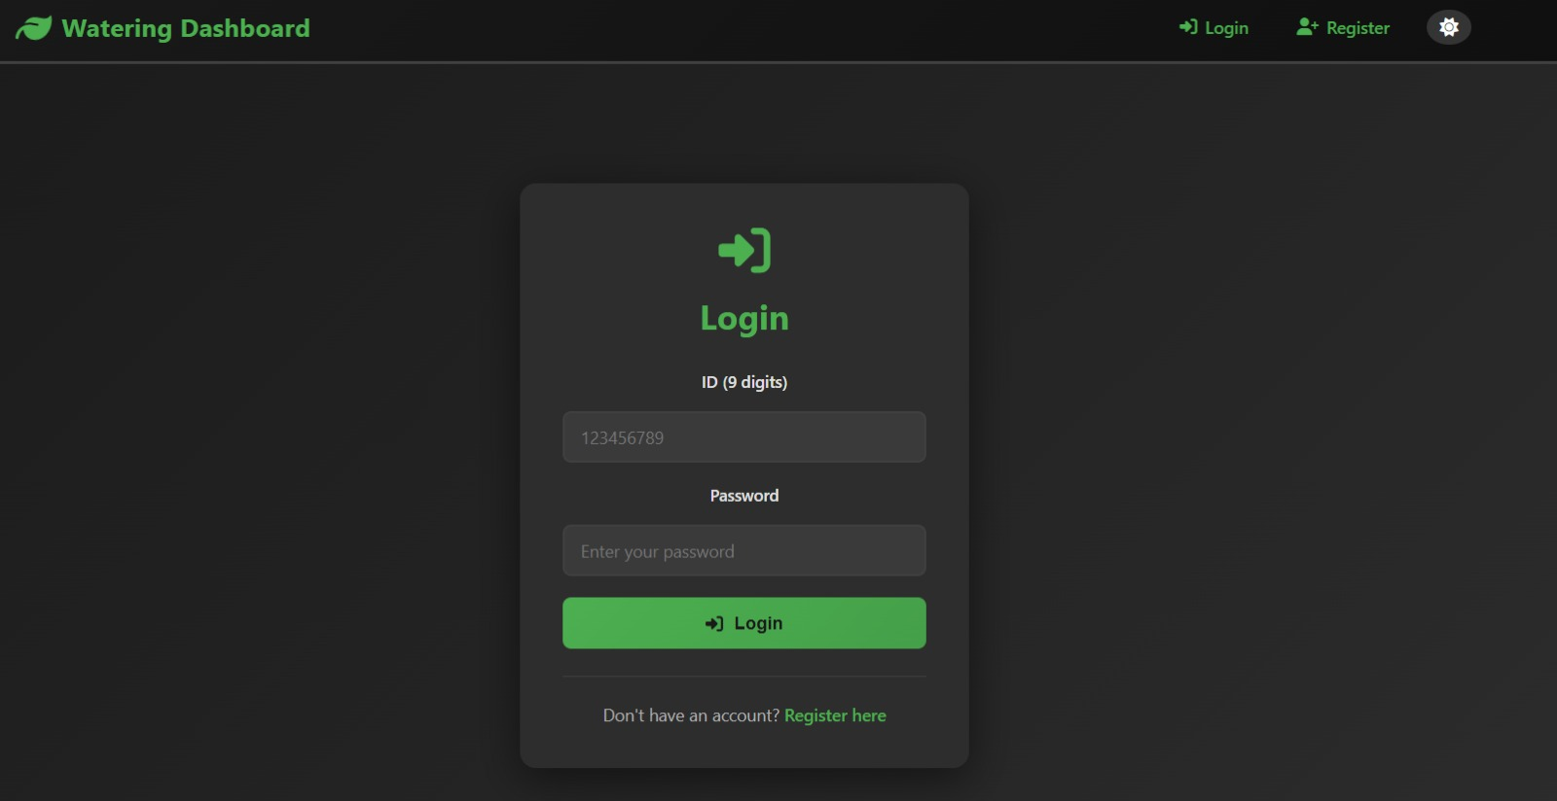
Main products: Login Page:

Slide 19
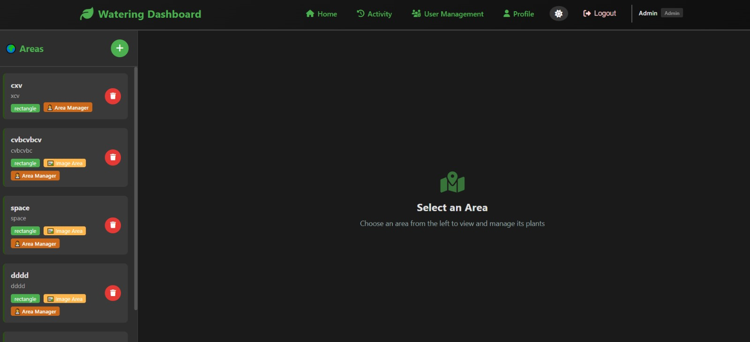
Main products: Home Page-After Login:

Slide 20
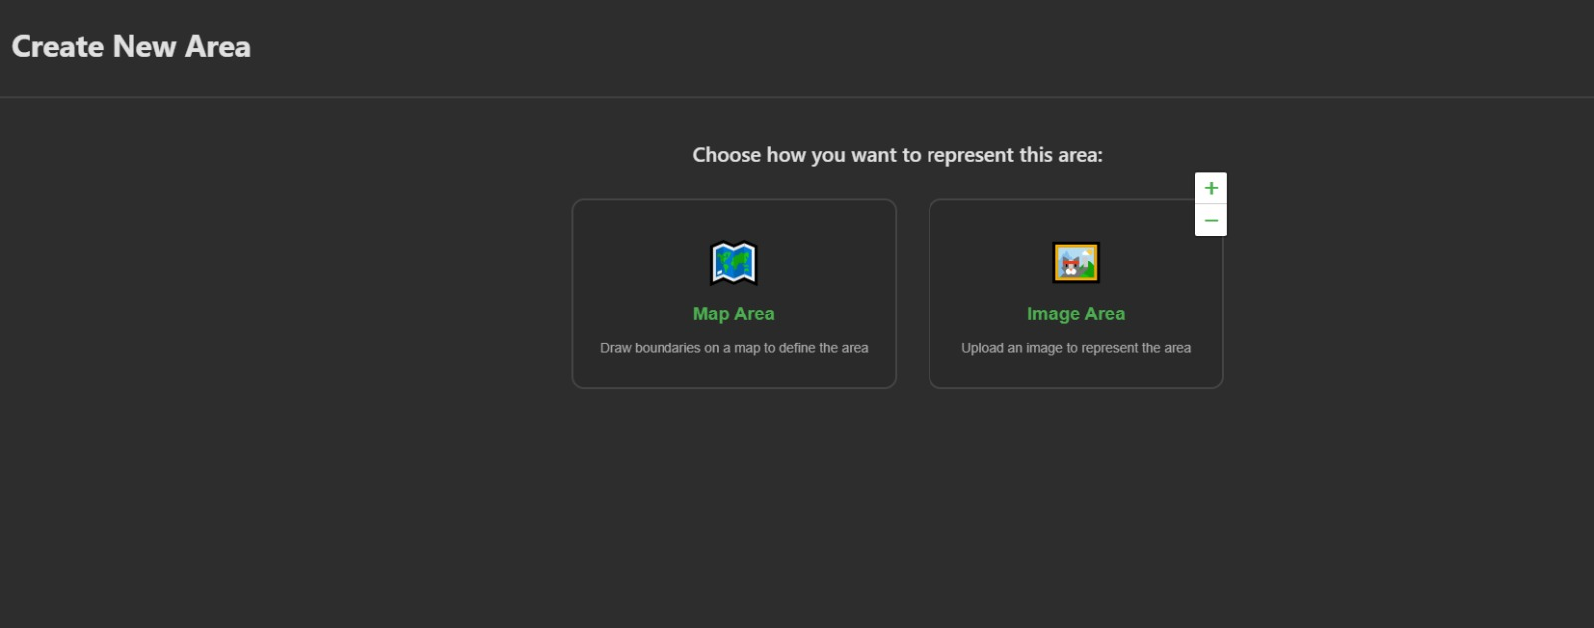
Main products: Create New Area:

Slide 21
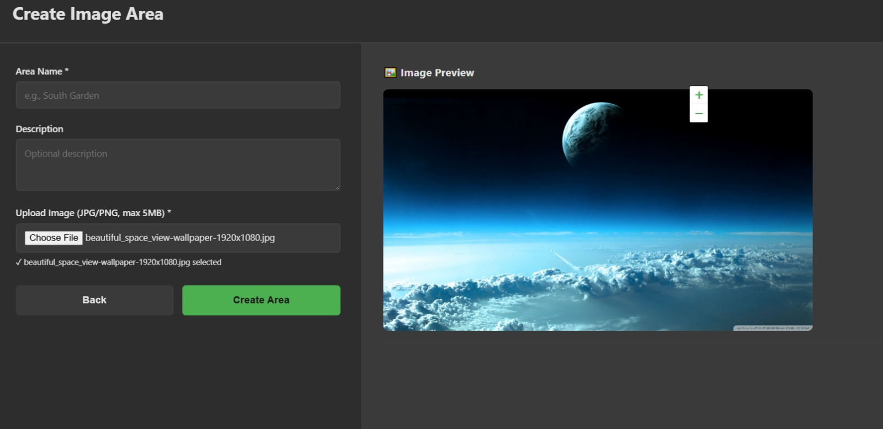
Main products: Create Image Area Page:

Slide 22
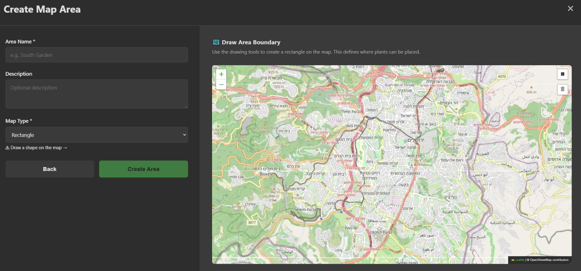
Main products: Create Map Area Page:

Slide 23
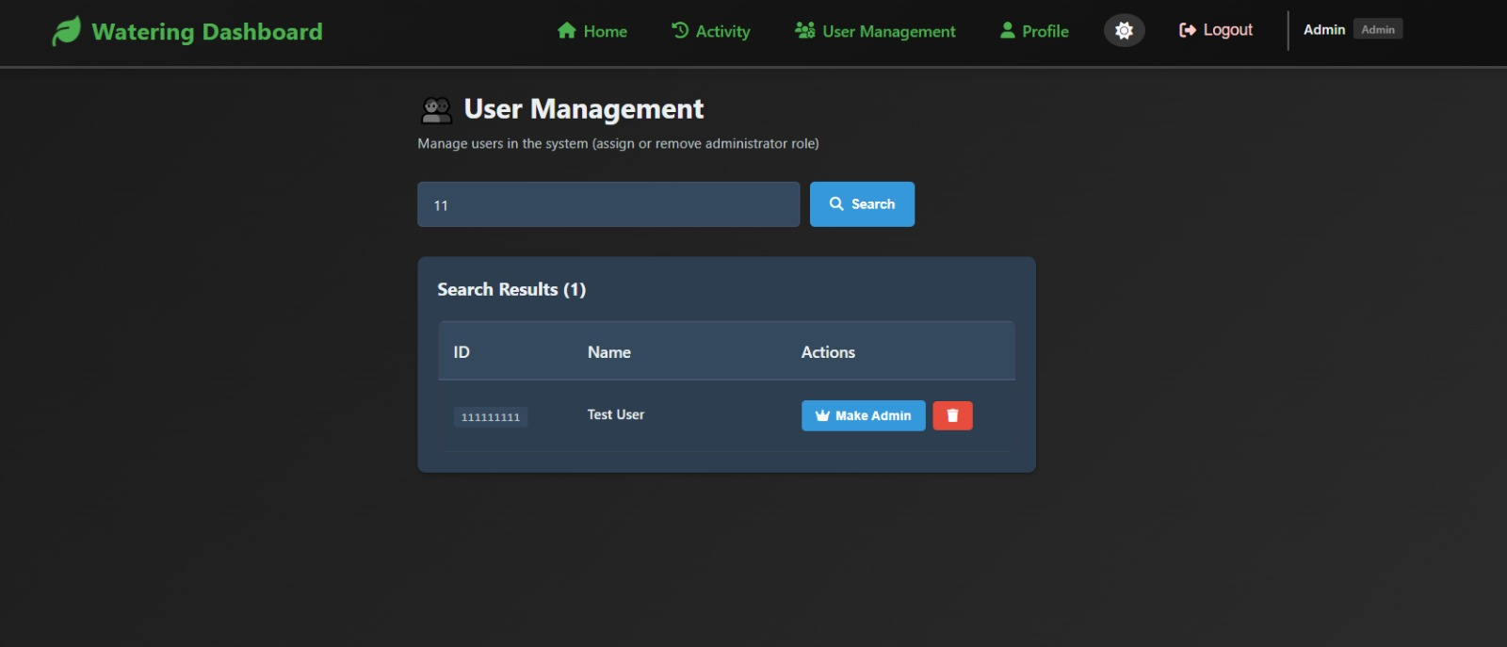
Main products: User Management Page:

Slide 24
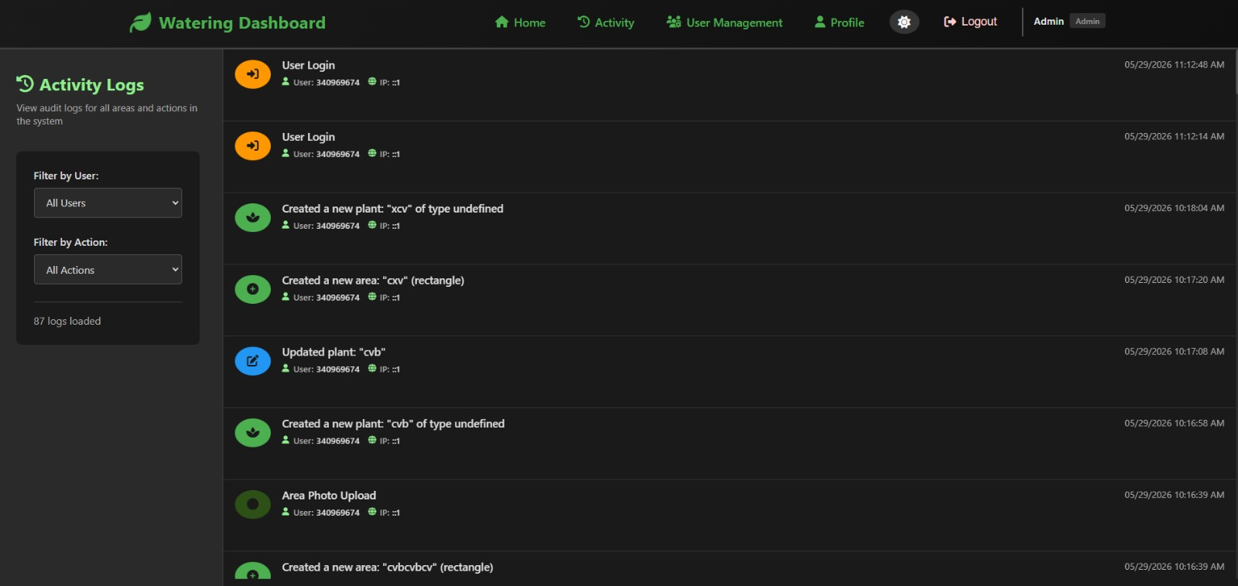
Main products: Activity Logs Page:

Slide 25
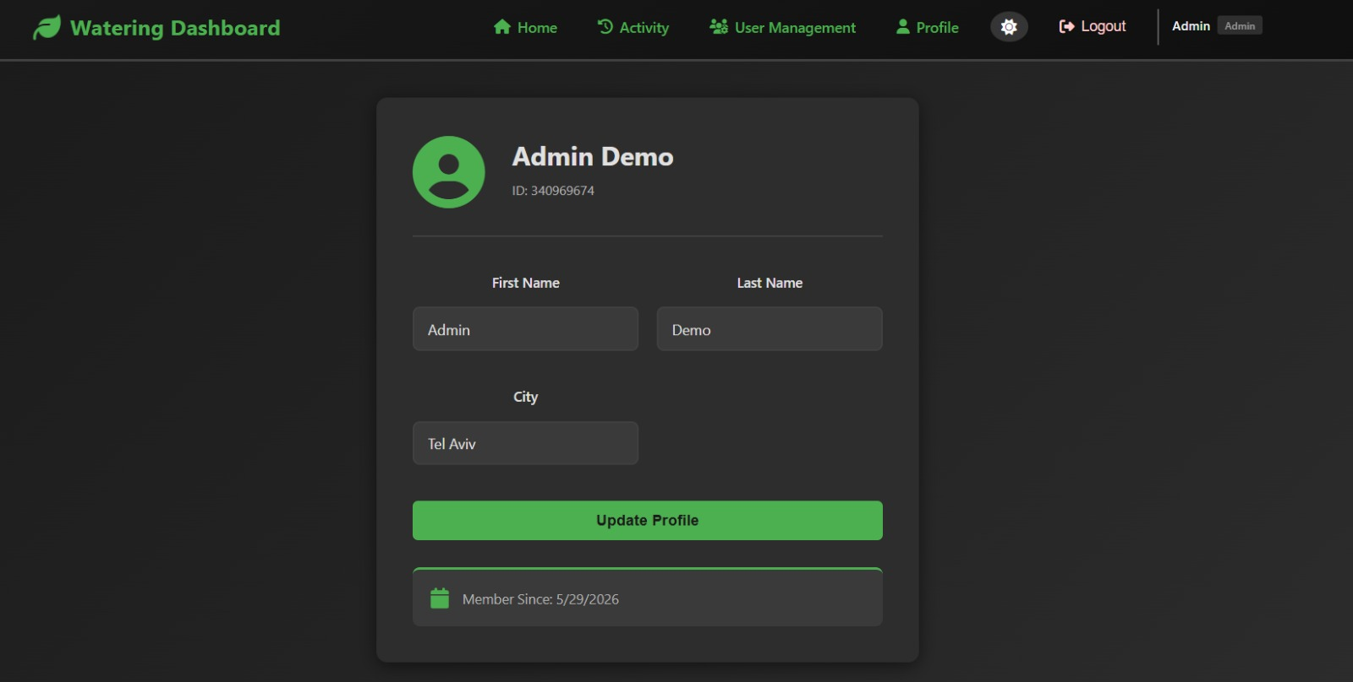
Main products: Profile Page:

Slide 26
Requirements from the Specification Document
Data accessibility from a desktop browser.
Ability to upload images for watering areas.
Ability to create areas and plants.
Permission system for registered users, area managers, and admins.
Ability to assign users to specific watering areas.
Ability to register and log in to the website.
Audit log for tracking system actions.

Slide 27
Unexpected Problems
Database structure and relations between users, areas, plants, and permissions required several redesigns.
Map layers and popups appeared above modals and dropdowns.
Plants could be created with invalid coordinates or outside the selected area.
Image-based areas needed a different coordinate validation flow.

Slide 28
Coping and Solving
DB redesigns → structured migrations: Re-modeled tables, added RBAC and area permissions, and wrote repeatable SQL migrations.
Map overlay issue → CSS isolation: Fixed stacking contexts, modal portals, and map layer behavior.
Invalid plant positions → validation and constraints: Required area selection, server-side boundary checks, and clear error messages.
Image coordinates → saved image dimensions and validated plant points inside the uploaded image.

Slide 29
Conclusions for Further Development
Add Google Maps or satellite map layers to display watering zones more realistically.
Add mobile support for workers inspecting plants in the field.
Integrate soil-moisture sensors and automatic watering alerts.
Improve the admin dashboard with analytics and visual reports.
Use cloud technologies for scalability and reliability.

